Slide 1

RUNGTA COLLEGE OF DENTAL SCIENCES & RESEARCH
TITLE OF THE TOPIC: TRAUMATIC INJURIES
DEPARTMENT OF CONSERVATIVE DENTISTRY AND ENDODONTICS

Slide 2
Specific learning Objectives
At the end of this presentation the learner is expected to know
Core areas* H | Domain ** | Category #
Classification of fractures,etiology of fractures complicated and uncomplicated crown fractures, | Cognitive | Must know
Clinical examination of tooth fracture, Avulsion | Psychomotor | Nice to know
Luxation injuries, root fracture | Affective | Desire to know
*Subtopic of importance
** Cognitive, Psychomotor or Affective
# Must know , Nice to know & Desire to know

Slide 3
Table of Content
Introduction
Classification
Etiology and causes
Clinical examination
Enamel fractures
Uncomplicated crown fracture
complicated crown fracture
Crown root fracture
Root fracture
Luxation injuries
Avulsion
conclusion

Slide 4
subluxation
Sensitivity to percussion
Increased mobility
No displacement
Mangement
optional splinting for 2 to 3 weeks
D. Diagnosis
root fracture
Pulp death in 12 to 20%

Slide 5
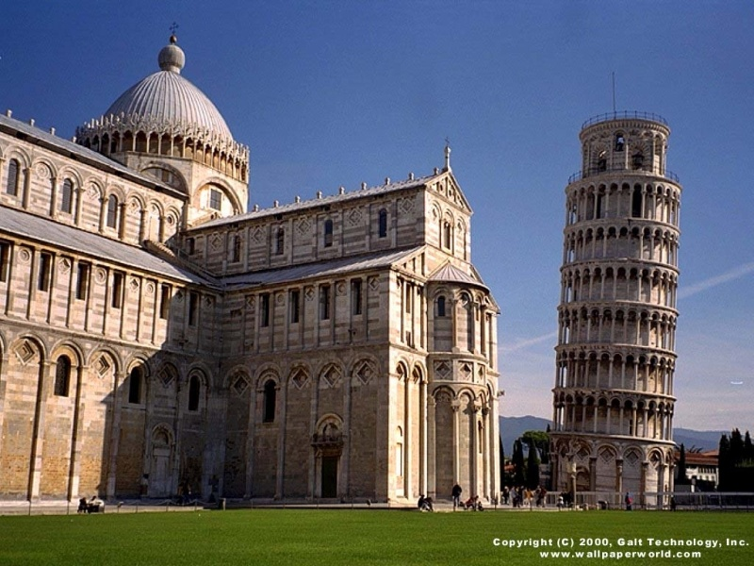
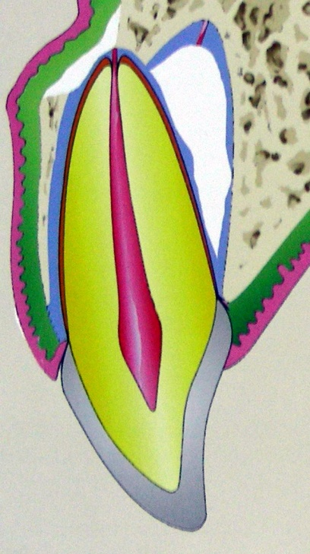
Lateral luxation
Displacement labially, mesially, distally or palataly
Management
repositioning
splinting (3 to 4 weeks)

Slide 6
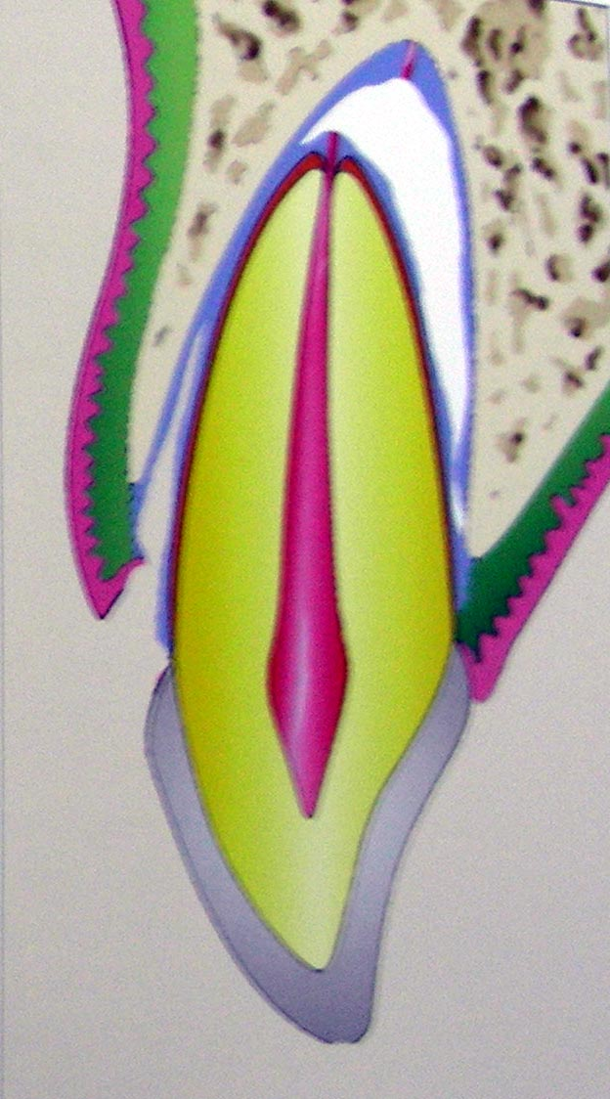
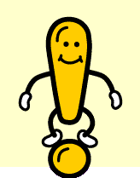
Extrusive luxation
Displacement in coronal direction
D.Diagnosis
root fracture
Management
Repositioning
Splint – 4 to 8 weeks

Slide 7
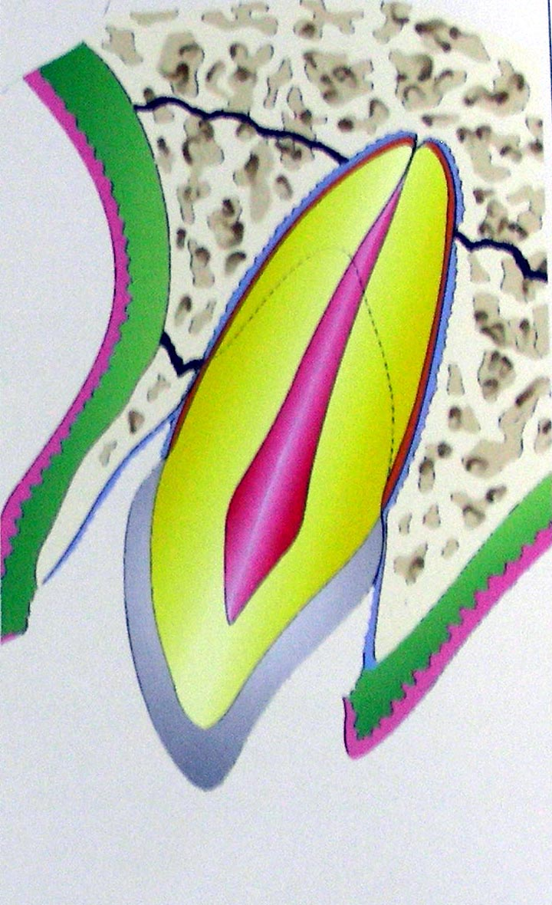
Intrusive luxation
Displacement in apical direction
into alveolus
Poorest prognosis
Management
No treatment in immature teeth
Repositioned – surgical or
orthodontic or combination

Slide 8
Sequalae to luxation injury
Yellow discoloration
Grey discoloration
Resorption – 5 to 15%
Incomplete root formation
Primary teeth – pulp space obliteration by calcification

Slide 9
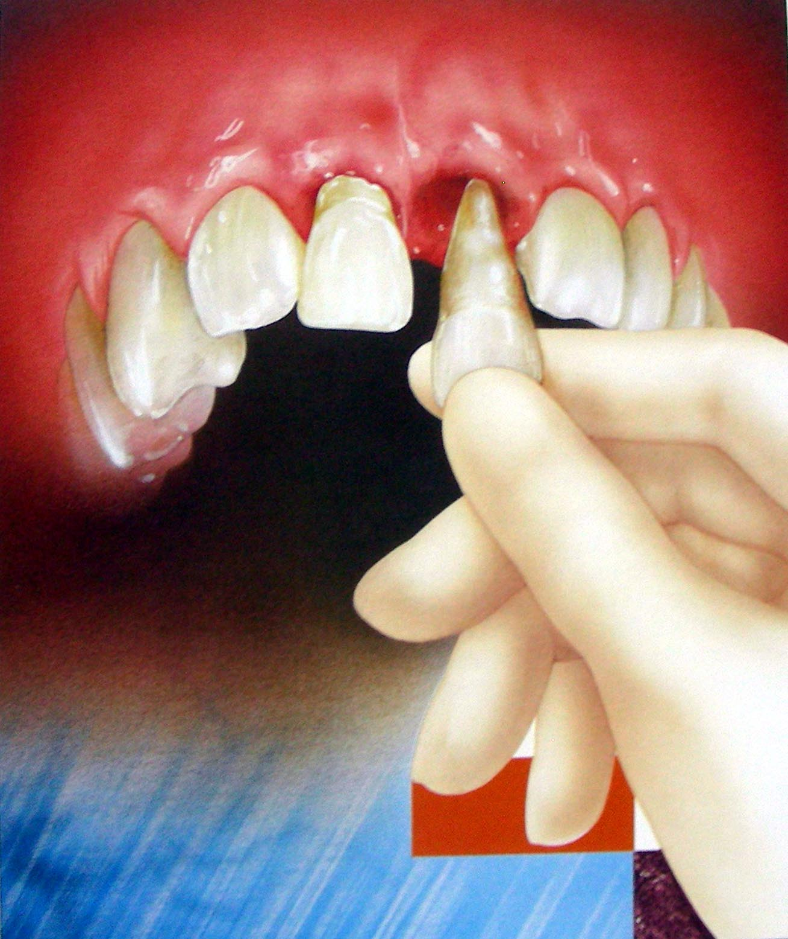
AVULSION

Slide 10

‘EXARTICULATION’
Attachment damage and pulp necrosis
Why osseous replacement or replacement
resorption occurs???
External inflammatory resorption after avulsion???

Slide 11
Treatment objectives
Avoid or minimize – inflammation
1. attachment damage
2. pulpal infection
Severe damage – steps to slow down replacement resorption

Slide 12
Management
Emergency treatment at the accident site
‘replant if possible or place in proper storage medium’
important factor -
What happens on drying???
Replant -
If cant be replanted – STORAGE MEDIUM
speed
within 15 to 20 minutes

Slide 13
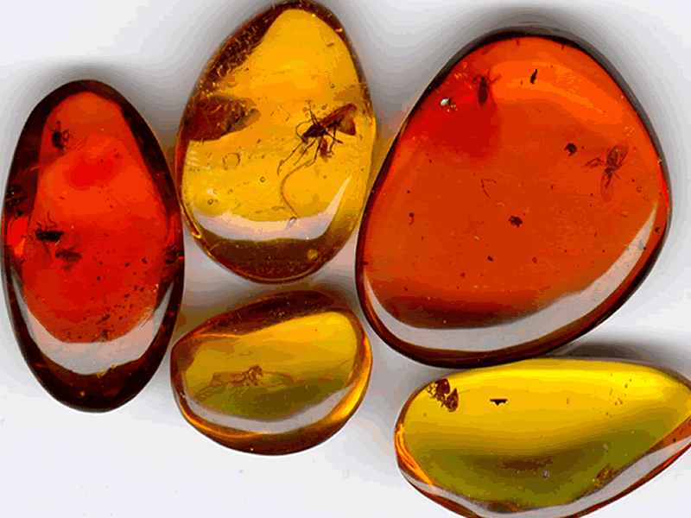
STORAGE MEDIUMS

Slide 14
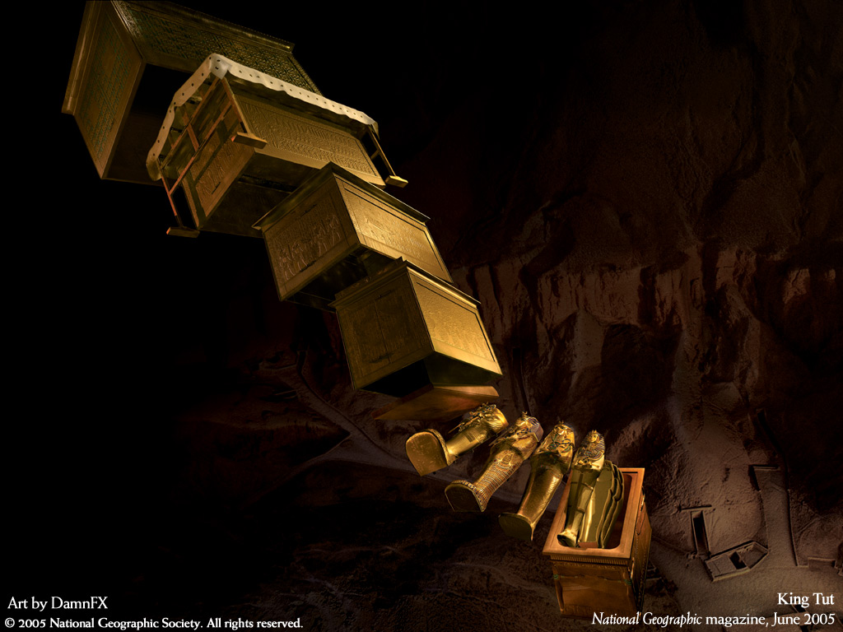
Storage medium
Desired – PDL viability
Saliva, saline and tap water
Hanks balanced salt solution (HBSS)
standard saline solution
non toxic, pH balanced and contains essential nutrients
‘Save-A-Tooth’
– no longer recommended

Slide 15
Milk
PDL cell viability – physiological osmolality
Milk with a lower fat content more useful at maintaining cell viability than milk with higher fat content (Sigalas et al ’04)
longer shelf life milk with lower fat content – tested (Ozan et al’07)

Slide 16

Propolis
Multifunctional material
anti inflammatory, antibacterial, antioxidant, antifungal, antiviral and tissue regenerative
properties
Why antioxidant property important??
10% Propolis better than milk, HBSS
(Ozan et al’07)

Slide 17
Order of preference
By literature
Propolis
HBSS
Long shelf life Milk with low fat content
Milk with high fat content
Saline
Saliva
By availability
Long shelf life milk with low fat content
Milk with high fat content
Saline
Saliva
Contact lens solution – alternative (Sigalas et al’04)

Slide 18
Clinical Management of avulsed teeth
Preparation of root
Extra oral time
Less than 60 minutes
Greater than 60 minutes
Root development
Closed apex
Open apex

Slide 19

Extra oral time less than 60 minutes
Closed apex
dry time – 15 to 20 min
dry time – 20 to 60 min
Endodontic treatment initiated – 7 to 10 days
Long term CaOH therapy
Inflammatory root resorption
ledermix
calcitonin

Slide 20
Open apex
soaking in doxycycline or covered with minocycline for 5 min before replanting
Enhances pulpal revascularization ??
(Ritter et al’04)
Reason – antimicrobial effect + MMP inhibition
Endodontic treatment avoided, signs of revascularization
apexification

Slide 21

Extra oral time more than 60 minutes
Closed apex
removal of PDL using acids for 1 min, soaking in fluoride
2% stannous fluoride for 5 min and replanted
1% stannous fluoride and tetracycline
(Selvig ’92)
ENDODONTIC TREATMENT – extraorally or similar to treatment of teeth with less than 60 min extra oral time

Slide 22
EMDOGAIN
Increase resistance to root resorption
Stimulate PDL regeneration
(Fillipi et al’01)
inhibits epithelial cell growth
How does it act ??
Emdogain – does not prevent progressive root resorption.
(Schjott at al’05)

Slide 23
Open apex
similar to closed apex
Children – don’t go for replantation
Present recommendation
Reason

Slide 24
PREPARARTION OF SOCKET
Left undisturbed
Light aspiration – remove blood clot
Alveolar bone collapse – reposition using blunt instruments
Rinse of emdogain

Slide 25
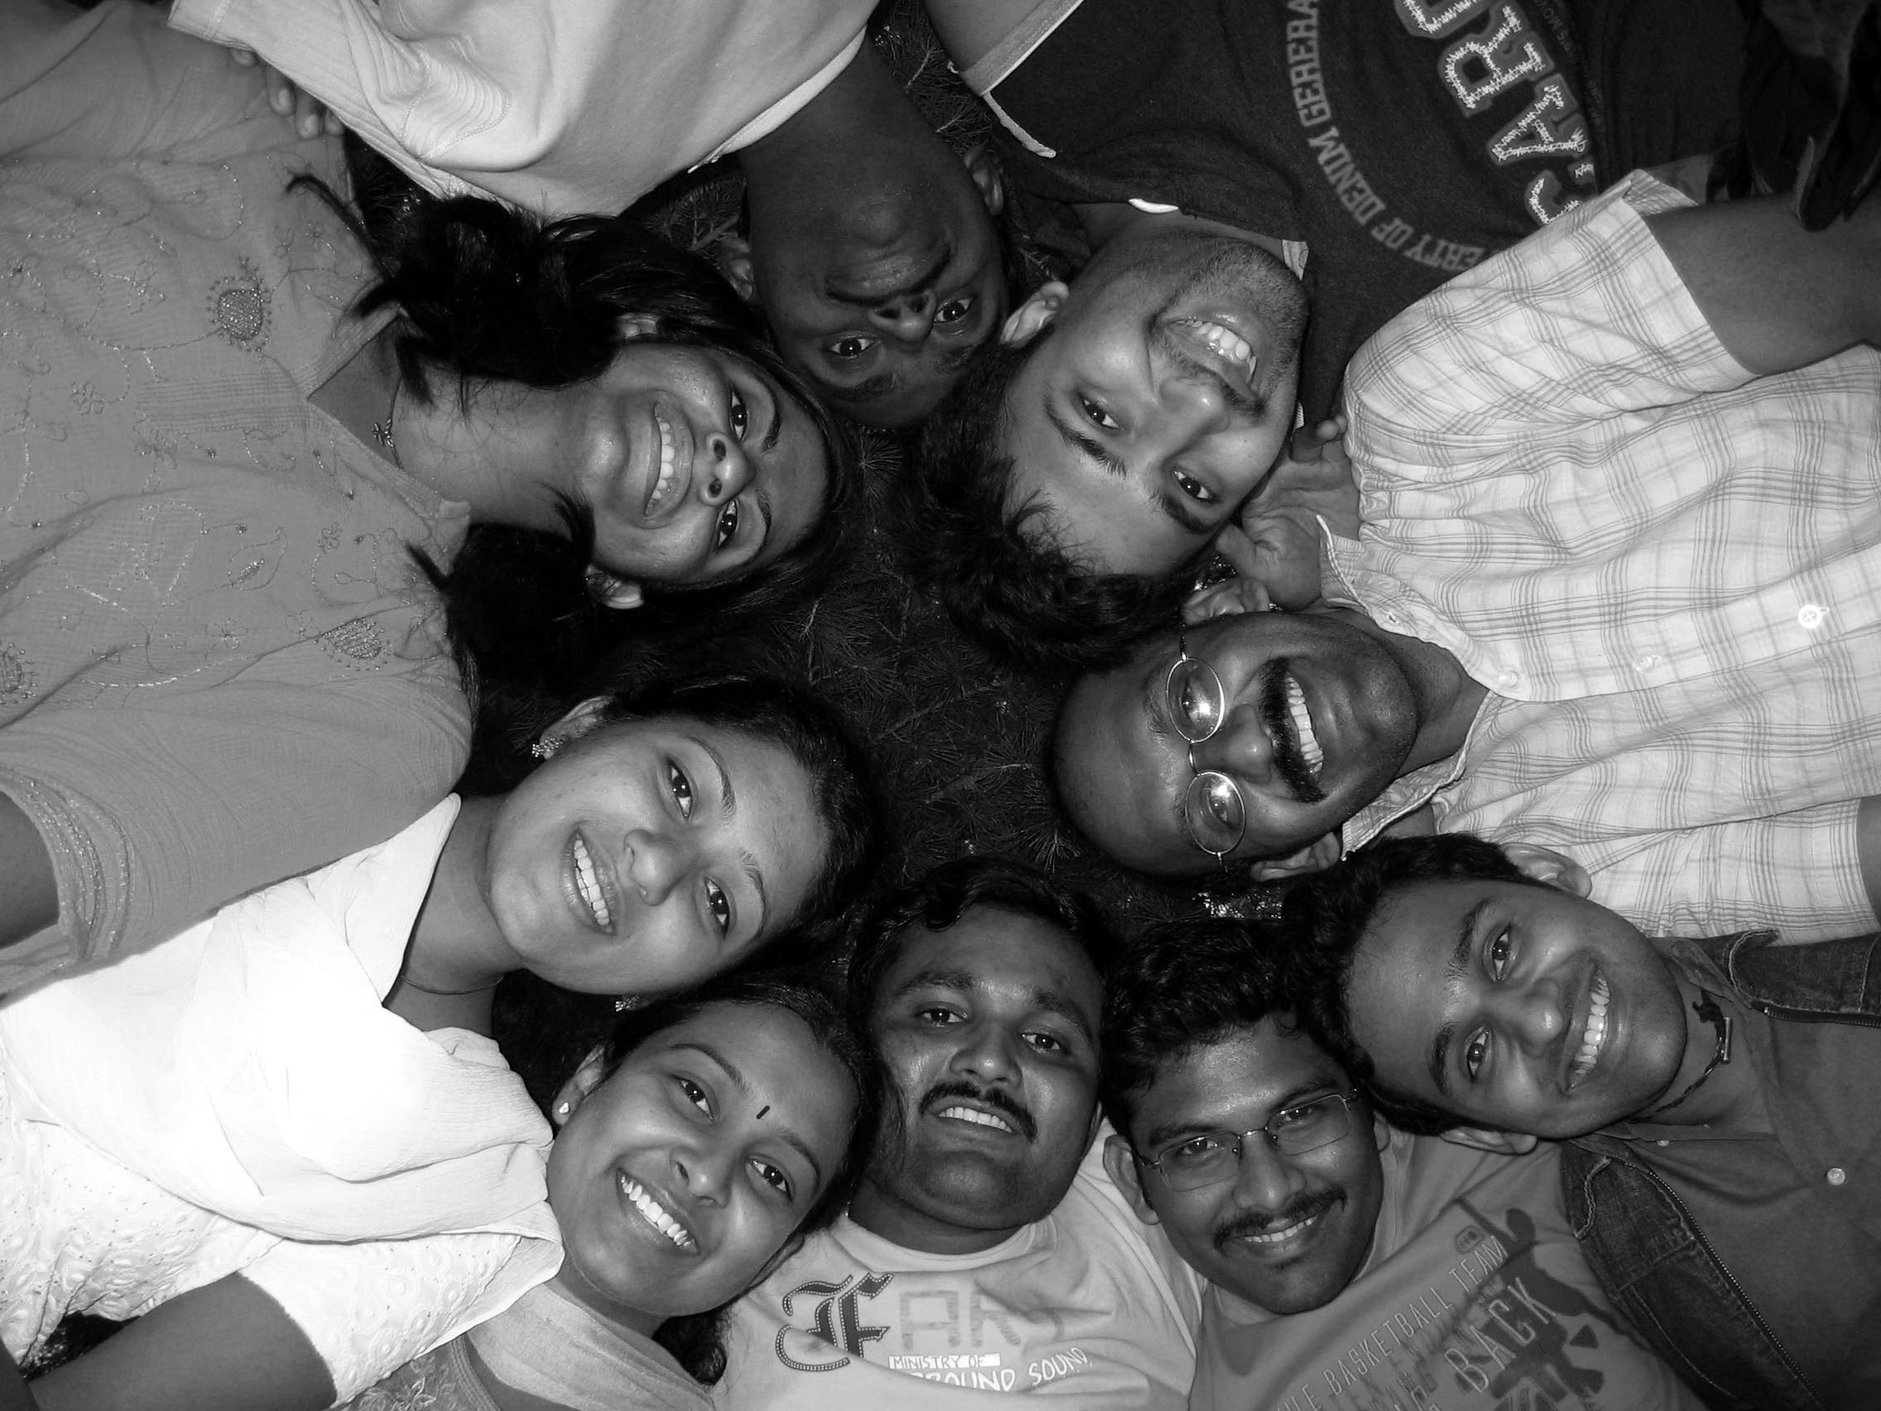
Splinting
Splinting – technique and duration
Splinting technique – physiological tooth movement
Duration – minimal

Slide 26
Splinting techniques
Rigid
Semi rigid
Types
Bracket splint
Composite Resin splint
Acrylic or gold cap splints
Orthodontic bands + arch bar splints
Composite – wire splint / bonded metal wire splint
Titanium trauma splint (TTS)

Slide 27
TTS required reduced chair side time – application and removal
(VonArx et al’01)
TTS and composite wire splint – less gingival irritation, well tolerated
(Fillipi et al’02)
TTS and composite wire splint – allowed physiological mobility

Slide 28
Duration of splinting
Root fracture – 2 to 4 weeks (2 – 4 months)
Avulsion – 7 to 10 days
Avulsion with alveolar fracture – 4 to 8 weeks
Lateral luxation – 3 to 4 weeks
Extrusive luxation – 4 to 8 weeks
Sub luxation – 2 to 3 weeks (optional)
concussion – 1 to 2 weeks (optional)

Slide 29
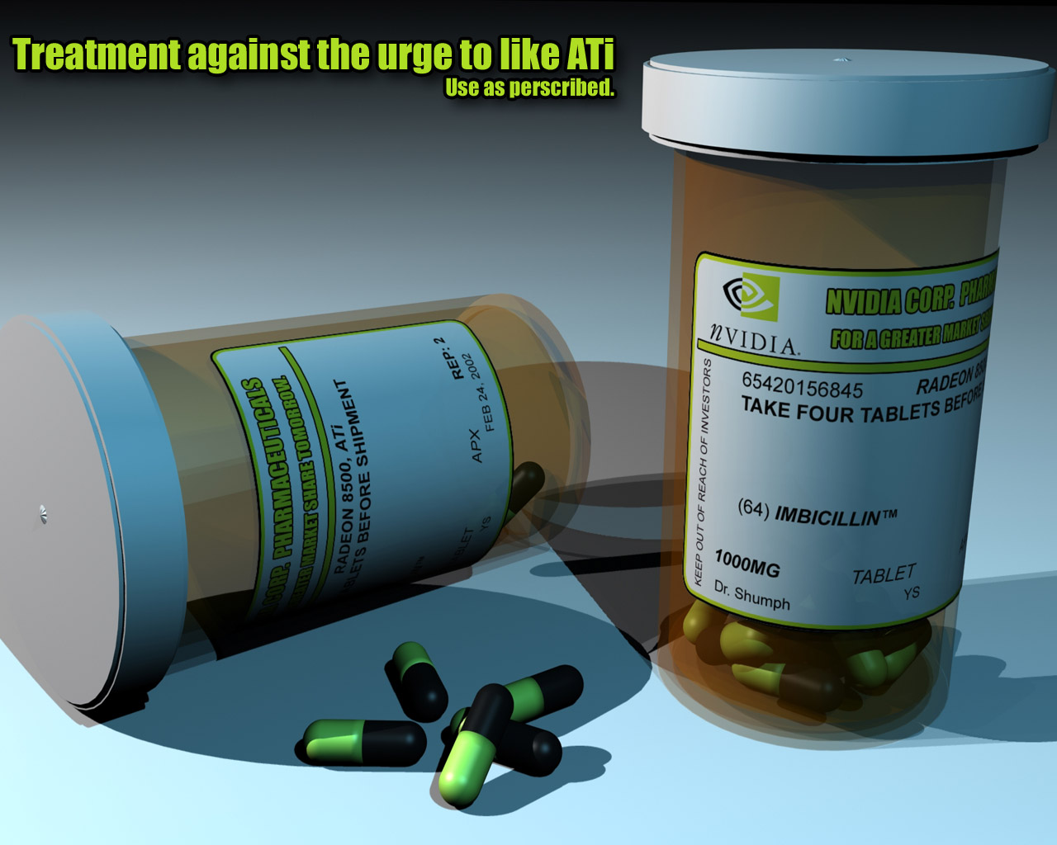
Adjunctive therapy
Systemic and topical antibiotic application
Tetracycline – affects osteoclast motility + reduction of collagenase effectiveness
(Sae-Lim et al’98)
Systemic pencillin
Chlorhexidine rinses
Tetanus booster – within 48 hours

Slide 30
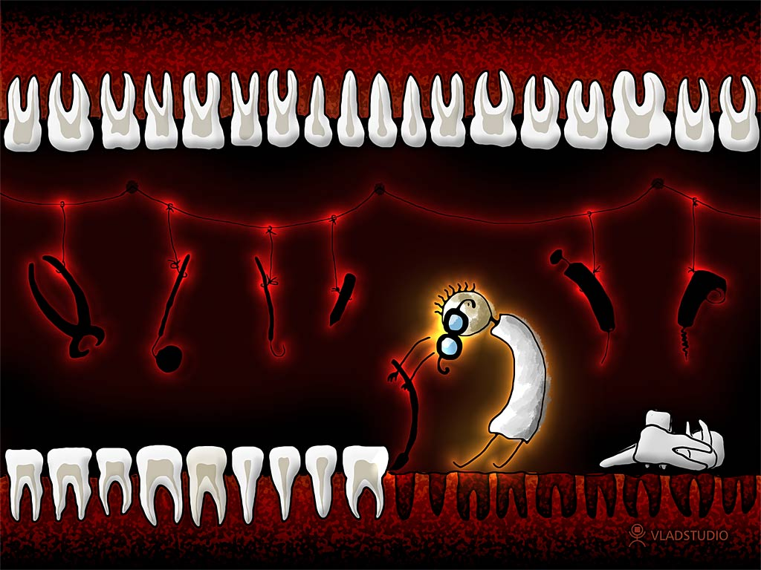
Conclusion
Various factors influence the outcome of teeth that
had undergone trauma. Correct diagnosis, quality and
timeliness of initial and long term treatment can improve
the prognosis of the traumatized teeth.

Slide 31
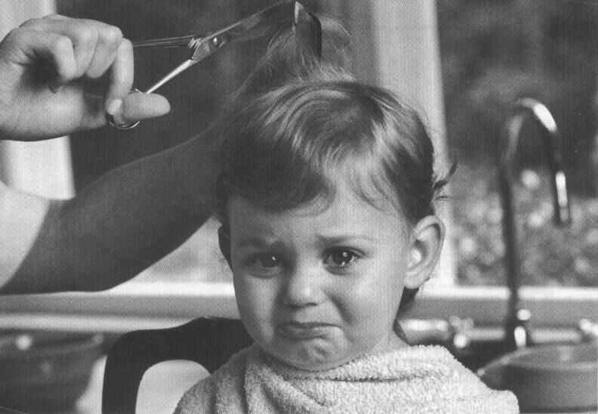
Thank U

Slide 32
Teaching Materials
Endodontic practices - Grossman
Pathways of pulp – Cohen
Textbook of Endodontics – Nisha Garg
Endodontics - Ingle

Slide 33
TAKE HOME MESSEGE/ FOR THE TOPIC COVERED (SUMMARY)
Various factors influence the outcome of teeth that had undergone trauma.
Correct diagnosis, quality and timeliness of initial and long term treatment can improve the prognosis of the traumatized teeth.

Slide 34
Question & Answer Session
Sequalae to luxation injury?
Enemerate different types of storage media

Slide 35
REFERENCES
Endodontic practices - Grossman
Pathways of pulp – Cohen
Textbook of Endodontics – Nisha Garg
Endodontics - Ingle

Slide 36
THANK YOU

